Slide 1
Parallel Sorting
Bitonic Mergesort
Yousef Saad – Mazen Khodier –
Omar Alaaeldein – Ahmed Dawood

Slide 2
Table of contents
Bitonic Mergesort
03
Complexity & Runtime Analysis
01
04
02
Parallel Implementation
Future Work
Algorithm
Conclusion
05

Slide 3
01.
Bitonic Sort Algorithm

Slide 4
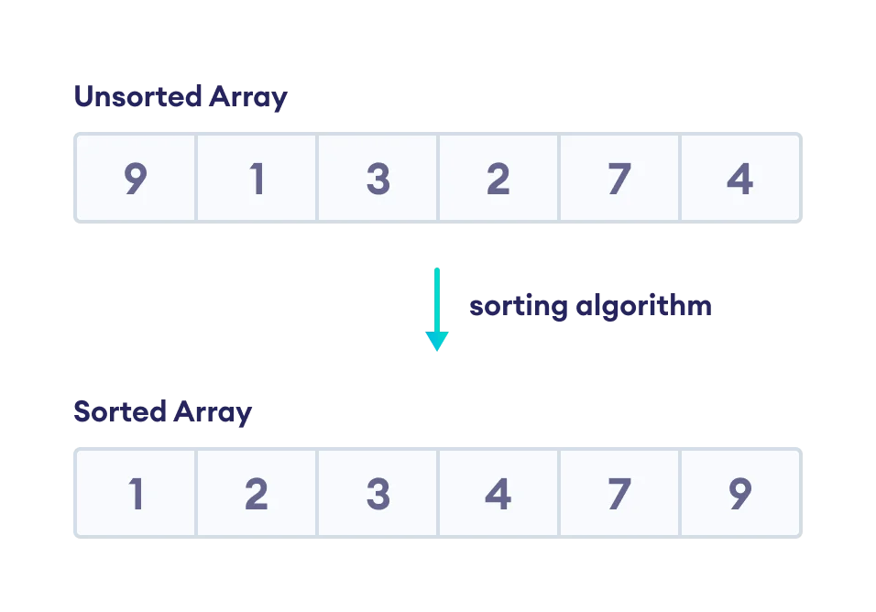
Problem Definition
Given an array, we need to sort it in ascending order such that elements will be arranged from smallest to largest (Sorting Problem).

Slide 5
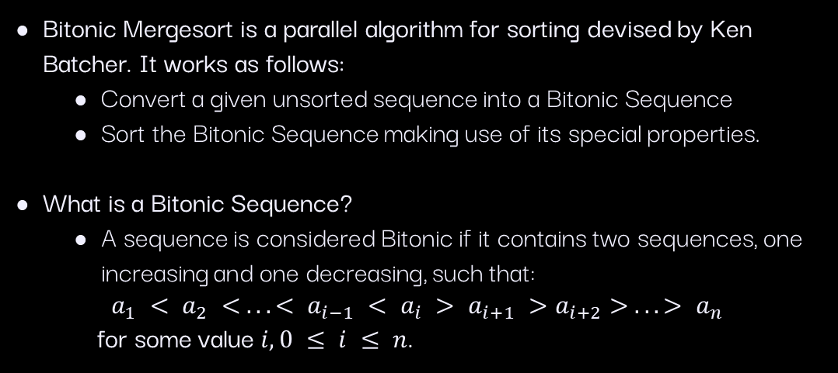
Bitonic Sort
Bitonic Mergesort is a parallel algorithm for sorting devised by Ken Batcher. It works as follows:
Convert a given unsorted sequence into a Bitonic Sequence
Sort the Bitonic Sequence making use of its special properties.
What is a Bitonic Sequence?
A sequence is considered Bitonic if it contains two sequences, one increasing and one decreasing, such that:
$$a_{1} < a_{2} < . . . < a_{i−1} < a_{i} > a_{i+1} >a_{i+2}> . . . > a_{n}$$
for some value $i, 0 ≤ i ≤ n$.

Slide 6
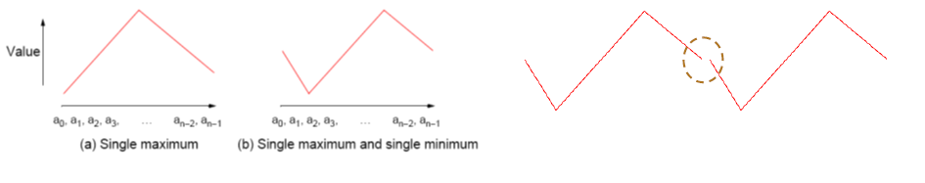
Bitonic Sequence
Defined as a list with no more than one local maximum and no more than one local minimum.
(c) Endpoints are considered wraparound

Slide 7
Bitonic Sequence Properties
1. Divide a Bitonic Sequence into two equal halves.
2. Compare-Exchange each item on the first half with the corresponding item in the second half.
Result:
Two Bitonic Sequences where the numbers in one sequence are all less than all numbers in the other sequence.

Slide 8
Bitonic Merge
Given a Bitonic Sequence:
Log(n) iterations (parallel steps) of ‘binary split’ will sort the list.

Slide 9
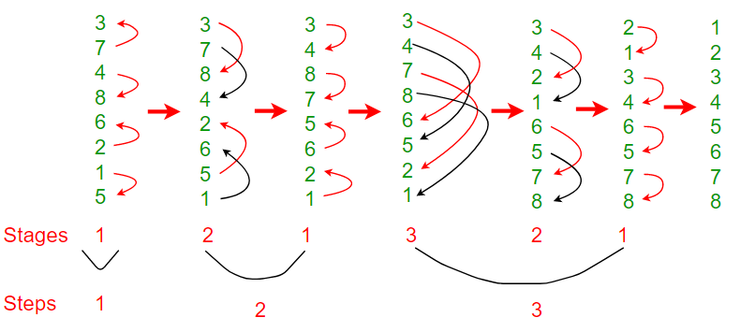
Making a Bitonic Sequence

Slide 10
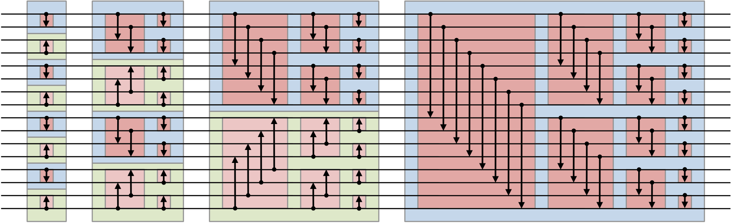
Bitonic Sorter Network
Converting the Unsorted list into a Bitonic Sequence
Sorting the Bitonic Sequence
Notes:
Merge: 1 3 8 4

Slide 11
02.
Parallel Implemen-tation
Using OpenMP in C++ Language

Slide 12
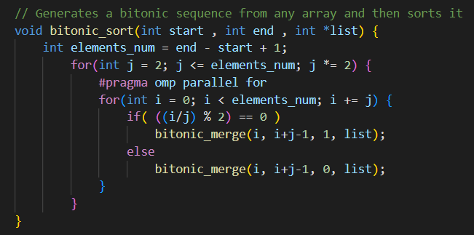
Bitonic Mergesort

Slide 13
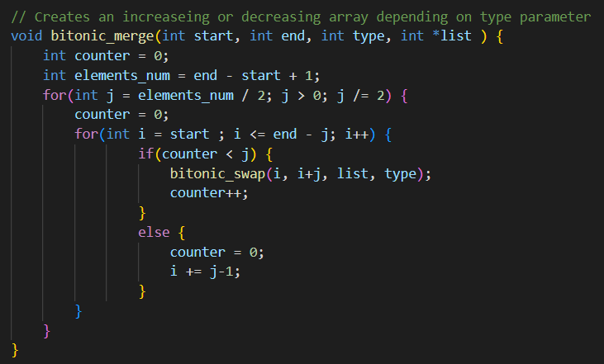
Bitonic Merge
Notes:
Merge: 1 3 8 4

Slide 14
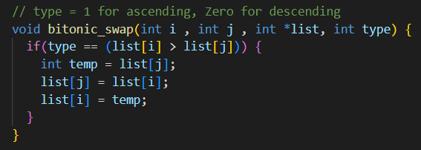
Bitonic Swap (Compare-Exchange)

Slide 15
03.
Complxity & Runtime Analysis

Slide 16
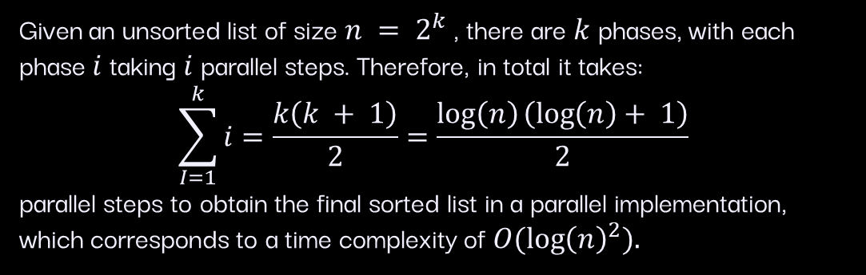
Time Complexity
Given an unsorted list of size $n = 2^{k}$, there are $k$ phases, with each phase $i$ taking $i$ parallel steps. Therefore, in total it takes:
$$\sum_{I=1}^{k}{i}=\frac{k\left(k + 1\right)}{2}=\frac{\log\left(n\right)\left(\log\left(n\right)+ 1\right)}{2}$$
parallel steps to obtain the final sorted list in a parallel implementation,
which corresponds to a time complexity of $O({\log\left(n\right)}^{2}).$

Slide 17
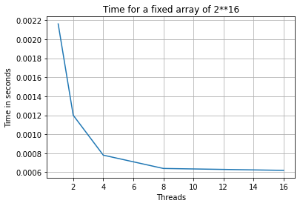

Performance on Array $of size 2^{16}$
Threads | Time (sec)
1 | 0.00216052
2 | 0.00120028
4 | 0.0007802
8 | 0.00064012
16 | 0.00062012
Notes:
Merge: 1 3 8 4

Slide 18
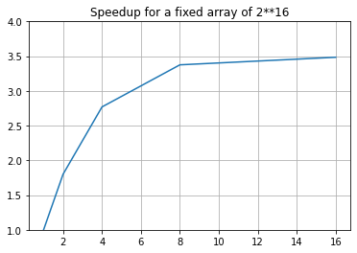
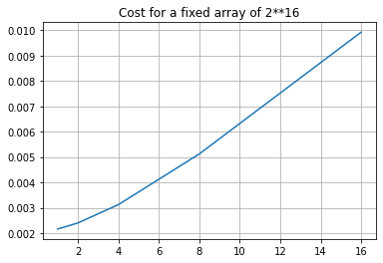

Performance on Array $of size 2^{16}$
Notes:
Merge: 1 3 8 4

Slide 19
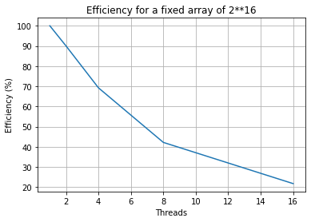

Performance on Array $of size 2^{16}$
Notes:
Merge: 1 3 8 4

Slide 20
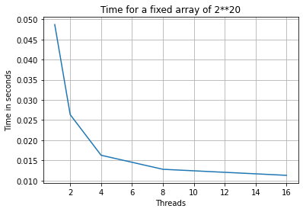

Performance on Array $of size 2^{20}$
Threads | Time (sec)
1 | 0.0486912
2 | 0.026366
4 | 0.0162837
8 | 0.0128029
16 | 0.0113025
Notes:
Merge: 1 3 8 4

Slide 21
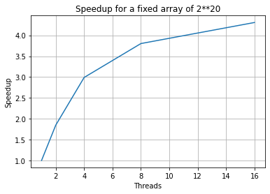
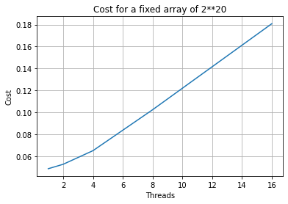

Performance on Array $of size 2^{20}$
Notes:
Merge: 1 3 8 4

Slide 22


Performance on Array $of size 2^{20}$
Notes:
Merge: 1 3 8 4

Slide 23
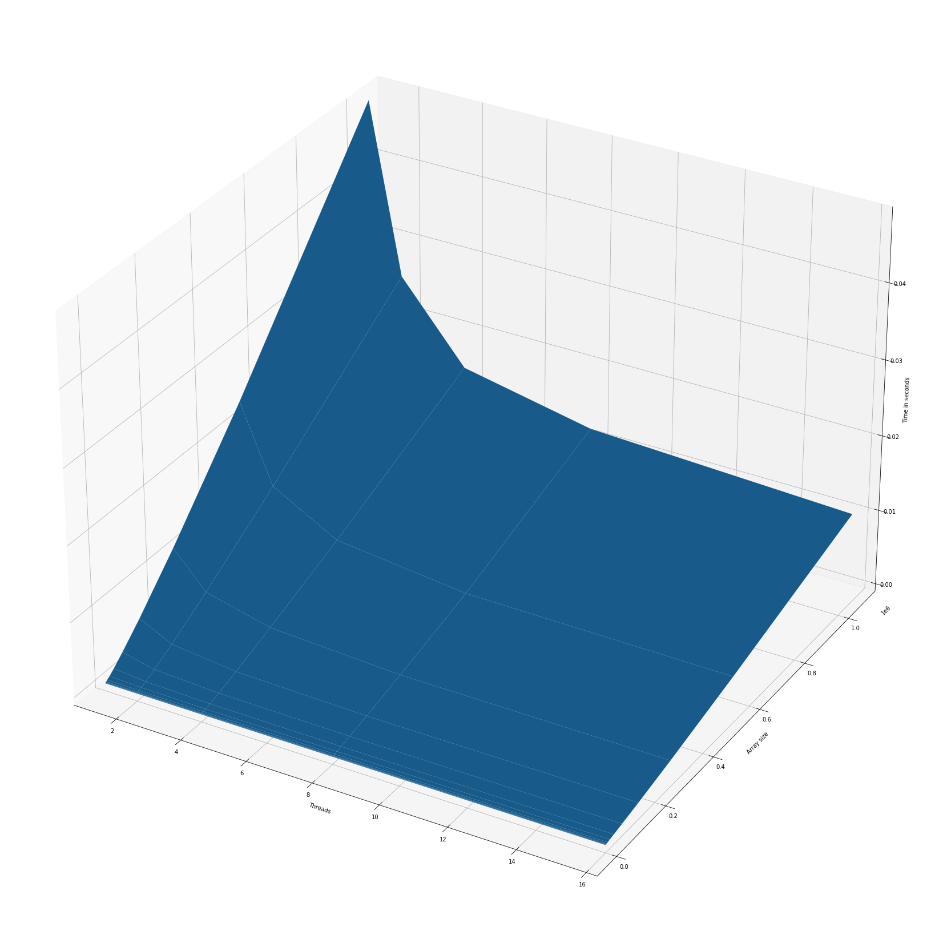
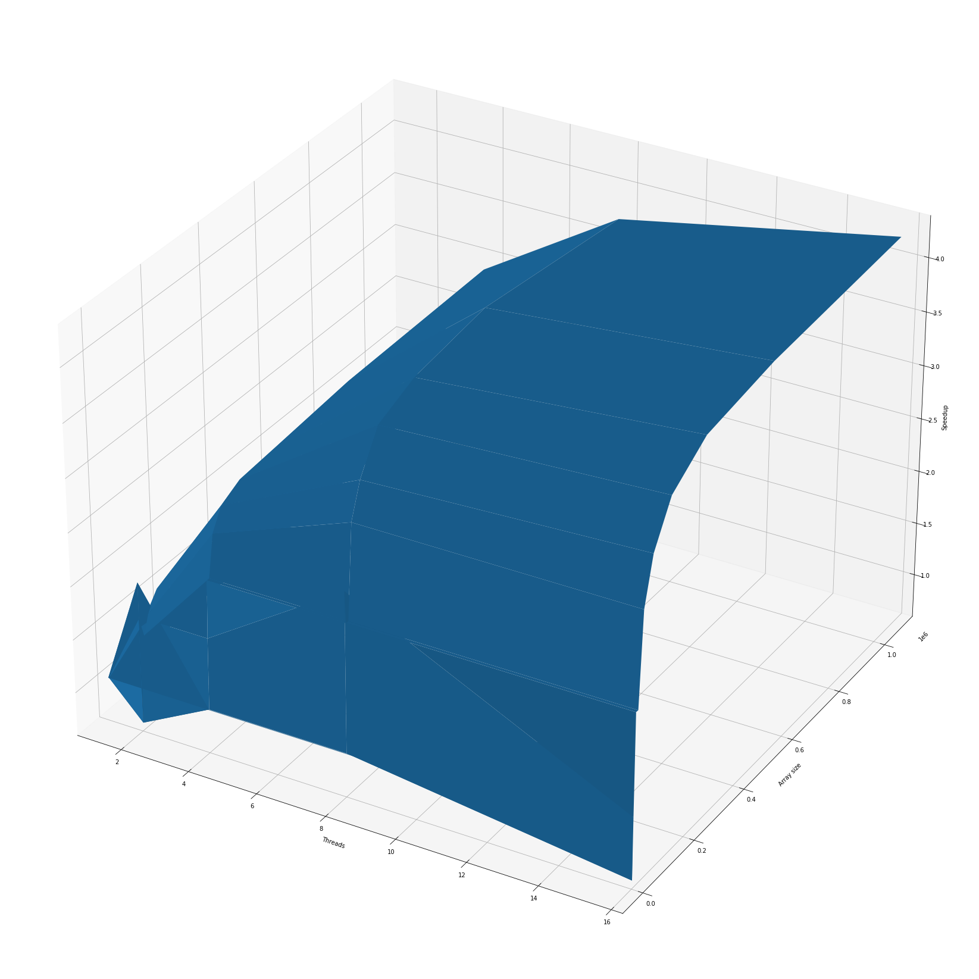
Runtime & Speedup Analysis
Notes:
Merge: 1 3 8 4

Slide 24
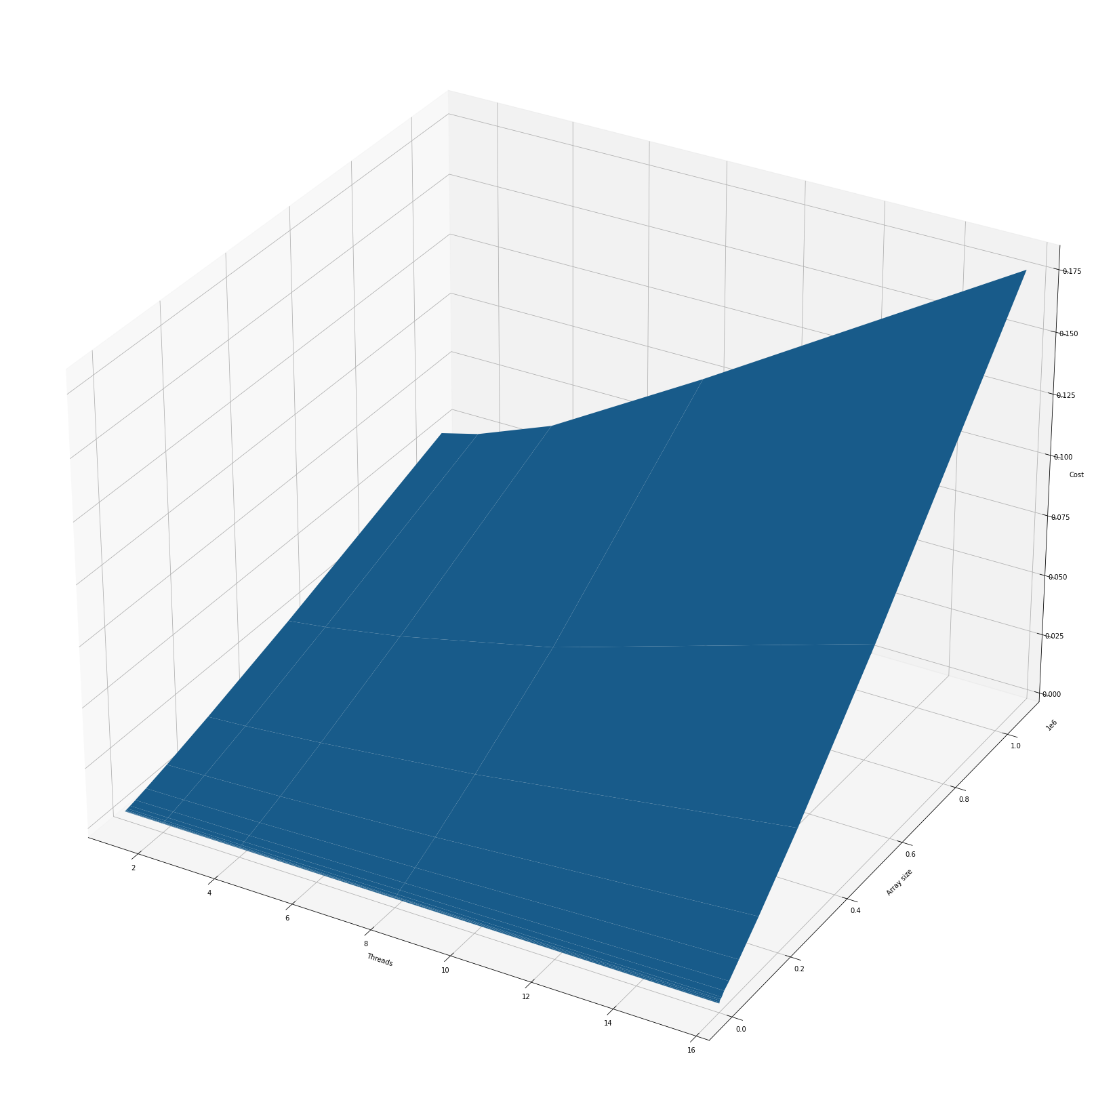
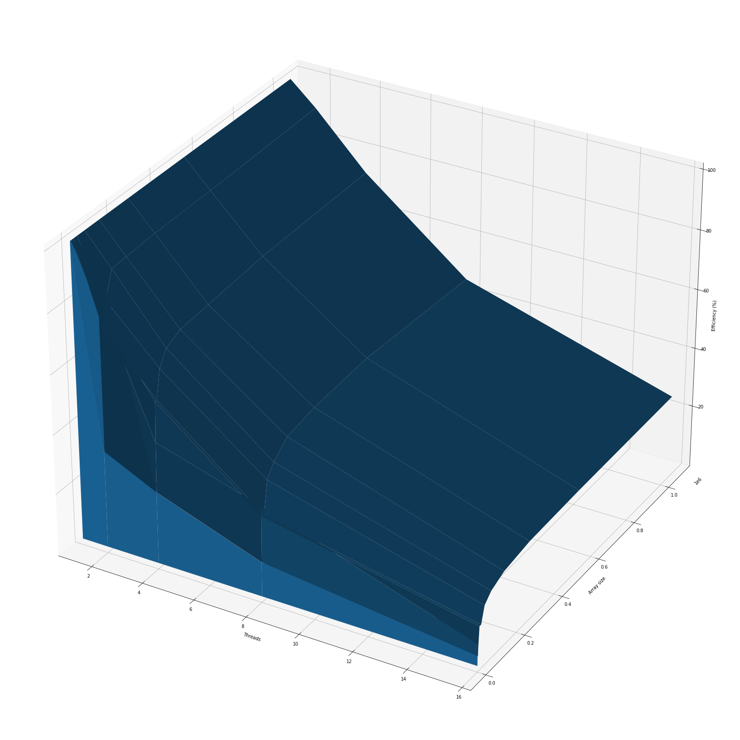
Cost & Efficiency Analysis
Notes:
Merge: 1 3 8 4

Slide 25
04.
Conclusion

Slide 26
Conclusion
Bitonic sort is a comparison-based sorting algorithm that can be run in parallel.
It is designed for parallel processors and its sequential implementation is inefficient compared to other sorting algorithms.
Bitonic Sort can perform very well when n/p is small, since it operates in-place and effectively combines messages.
On the other hand, its performance quickly degrades as n/p becomes large, which is the much more realistic scenario.

Slide 27
05.
Future Work

Slide 28
Future Work
Extend the algorithm to allow for Arrays of size not equal to powers of two.
Test on different distributions of input arrays:
Normal Distribution
Sorted
Reverse Sorted
Test against other sorting algorithms.

Slide 29
Thanks!

Slide 30
Extra
Bonus Slides for Illustration Purposes only.
Viewer Discretion is Advised.

Slide 31
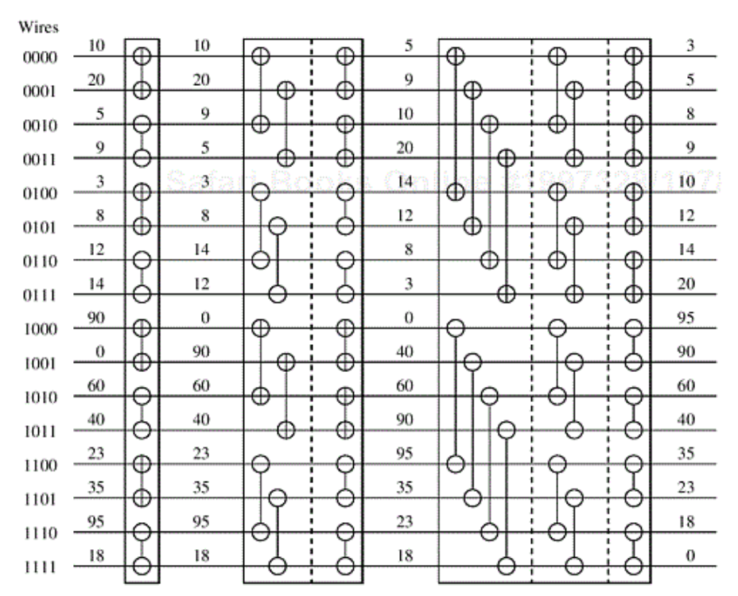
Creating Bitonic Sequence - Example

Slide 32
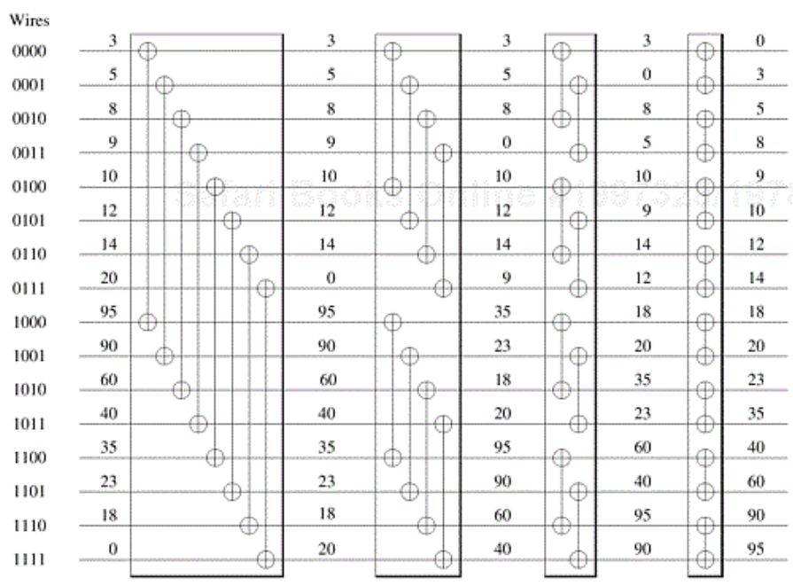
Sorting Bitonic Sequence - Example

Slide 33
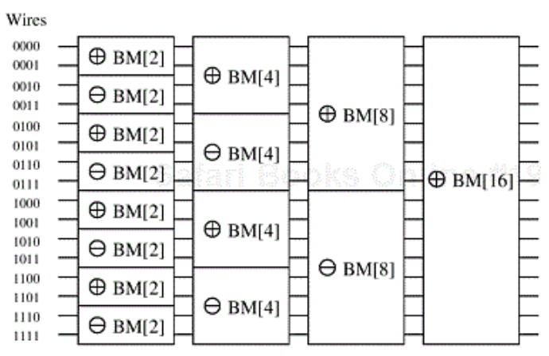
Bitonic Merging Networks

